Slide 1
Math 769: Statistical Learning

Slide 2
Tree Models and Random Forests
Shahrzad Jamshidi, PhD

Slide 3
Last Time
We discussed maximum likelihood inference, a method that constructs the model for which the data is maximally likely.
We also discussed Bayes theorem, which relies on setting a prior probability and sampling to compute 𝑃(𝜃│𝑍).
One can iterate this process until the parameters convert to an maximally likely probability.

Slide 4
Objectives
Define a decision tree and its components.
Describe the construction process of a decision tree.
Understand the decision tree diagram.
Define a random forest.
Describe its construction.
List its hyperparameters.

Slide 5
Decision Trees
Decision trees are a non-parametric supervised learning method used for both classification and regression.
They model decisions and their possible consequences as a tree-like structure, where nodes represent tests on attributes, and branches represent the outcomes of these tests.
Mathematically, these models can construct piecewise constant models.

Slide 6
Structure of a Tree
Root Node: Represents the entire dataset, which gets divided into subsets.
Internal Nodes: Each node corresponds to an attribute test.
Branches: Represent outcomes of tests, leading to new nodes.
Leaf Nodes: Terminal nodes that give a classification or decision (in classification trees) or a continuous output (in regression trees).

Slide 7
Construction of a Tree
Trees are built by recursively splitting the training set along one dimension into subsets based on an attribute value test.
Criteria for splitting include Gini Impurity, Entropy (for classification), and Variance Reduction (for regression).
The lower the better.
The process continues until a stopping criterion (like a maximum depth or minimum number of samples required to split) is reached.
The stopping criterion is a hyperparameter of the model that requires tuning.

Slide 8
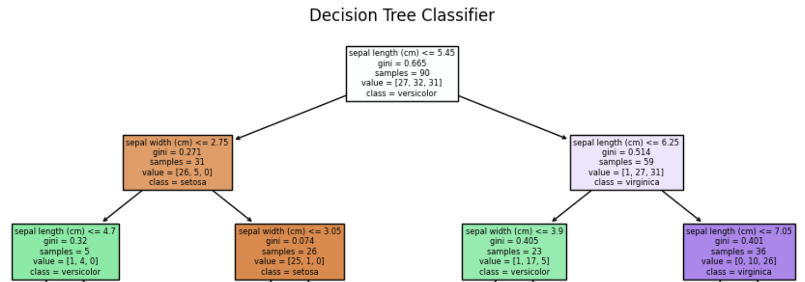
Decision Tree Diagram

Slide 9
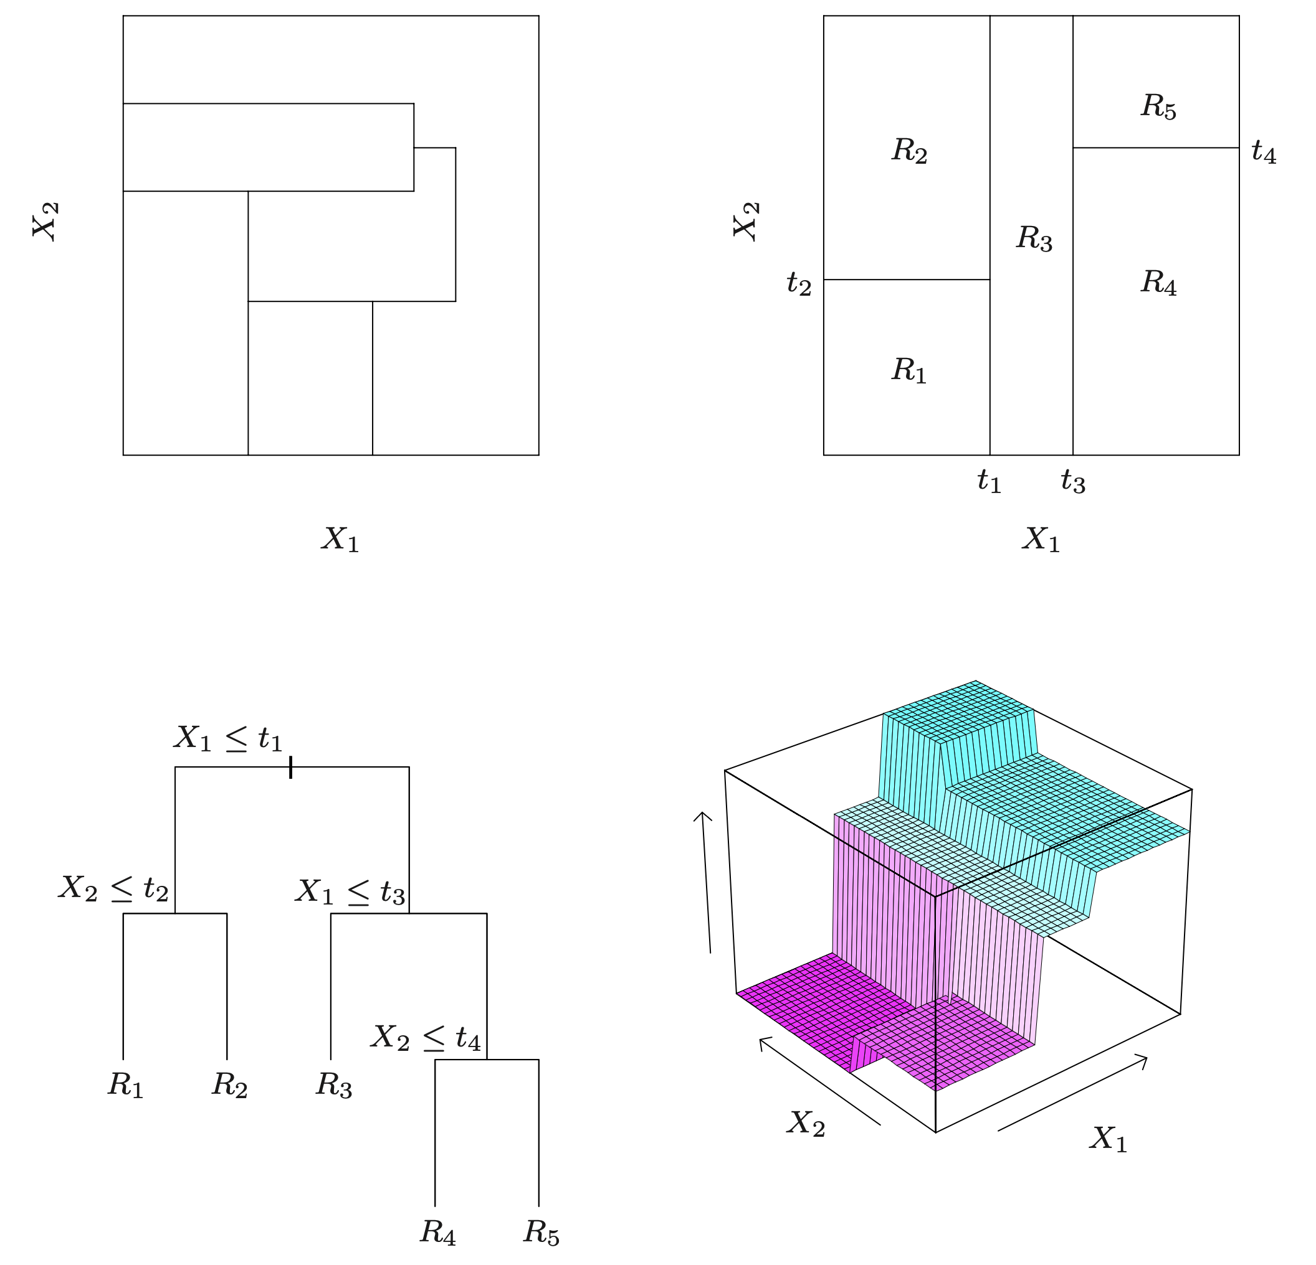
Decision Tree Function
Notes:
Top right panel shows a partition of a two-dimensional feature space by recursive binary splitting, as used in CART, applied to some fake data.
Top left panel shows a general partition that cannot be obtained from recursive binary splitting.
Bottom left panel shows the tree corresponding to the partition in the top right panel, and a perspective plot of the prediction surface appears in the bottom right panel.

Slide 10
Strengths and Weaknesses of Trees
Advantages
Easy to interpret and visualize.
Requires little data preprocessing (no need for normalization).
Can handle both numerical and categorical data.
Limitations
Prone to overfitting, especially if the tree is very deep.
Can be unstable because small variations in data might result in a completely different tree.
Biased with imbalanced datasets.

Slide 11
Random Forests
Random forests are an ensemble learning model constructed from multiple decision trees.

Slide 12
Random Forest Construction
Each tree in a random forest is built from a sample drawn with replacement (a bootstrap sample) from the training set.
When splitting nodes during the construction of trees, the best split is found from a random subset of the features.
These random choices insert more noise into the trees.
This enhancing the overall predictive performance.

Slide 13
Key Hyperparameters
Number of Trees: More trees increase performance but also computation time.
Max Depth of Trees: Controls the depth of each tree.
Min Samples per Leaf: Minimum number of samples required to be at a leaf node.
Max Features: The number of features to consider when looking for the best split.

Slide 14
Strengths and Weaknesses of Forests
Advantages
Strong performance with default settings.
Reduces overfitting compared to a single decision tree.
Effectively handles large datasets with higher dimensionality.
Limitations
Less interpretable than individual decision trees.
Can be computationally intensive, particularly in training and making predictions.
Overfitting can still occur with noisy datasets.

Slide 15
Conclusion
Decision trees construct piecewise flat functions based on successive splits along a specific feature, picked based on the lowest metric value such as Gini Impurity.
The construction can be visually depicted as a binary tree.
One picks some kind of stopping criterion has a hyperparameter to control overfitting.

Slide 16
Conclusion
Random forests are ensembles of several decision trees constructed from the same dataset.
Each tree is constructed from a bootstrapped sample; a random choice of candidate features are selected at each split.
These choices introduce noise into the trees, which lead to a stronger ensemble model since the noise “cancels out”.
There are four hyperparameters to pick for a random forest: the number of trees, the max depth, the minimum number of samples per leaf, and the maximum features.

